Slide 1
Sprint 2: LLM Benchmark Project
Format Comparison Study: CSV vs HTML vs JSON vs XML
Nishit Suthar
May 2026
🎯 Major Discovery: All Formats Converge to 80% in Individual Mode

Slide 2
Methodology & Key Insights
1. Synthetic Data Generation (Local, NOT LLM-Generated)
• Generated 32,550 music industry records using Python Faker library locally
• 11 relational tables with proper foreign key constraints and referential integrity
2. Strategic Data Degradation for Testing
• Sampled to 567 records (2.1%) to test LLM behavior with limited data
• Intentionally kept stale metadata (albums.total_tracks = 12-16 from full dataset)
• Actual tracks per album after sampling: 0-2 (testing metadata trust)
3. Multi-Format Conversion & Testing
• Converted sampled data to 4 formats: CSV (41KB), HTML (168KB), JSON (173KB), XML (211KB)
• 20 benchmark questions (6 Medium, 7 Hard, 7 Extremely Hard)
• Ground truth verified against NeonDB (PostgreSQL)

Slide 3
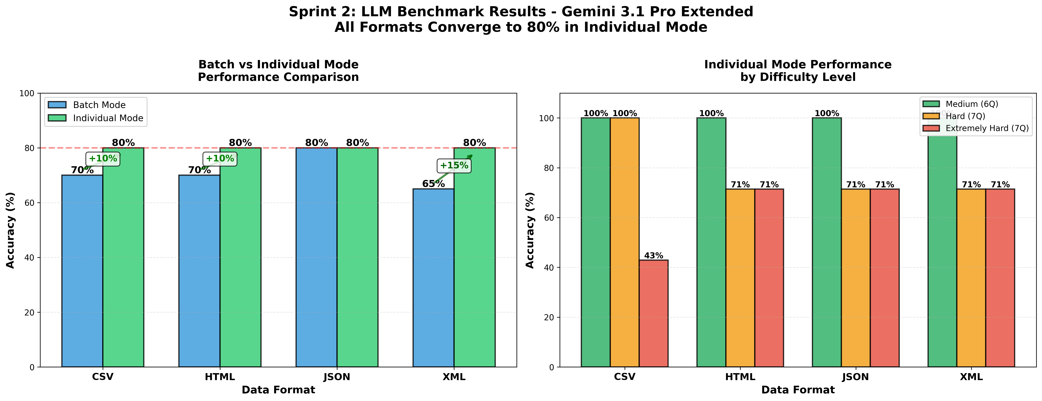
Results: Perfect Format Convergence at 80%
🔑 Key Findings:
✓ CSV: ONLY format to correctly handle stale metadata (Q007: Jazz = 2.0) | 100% on Hard questions
✓ XML: Biggest improvement (+15%) from 65% → 80% | HTML/JSON/XML: All used wrong aggregation (Jazz = 0.67)
✓ Individual mode eliminates format advantages: All converge to 80% ceiling despite different paths

